Slide 1
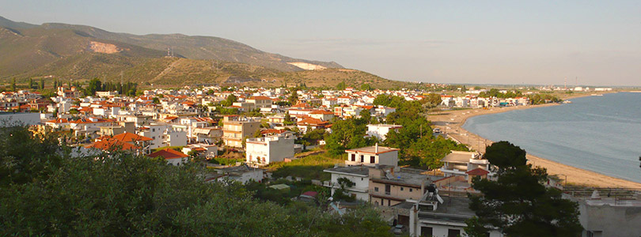
Greece-εllada
Primary school of Nea Karvali

Slide 2
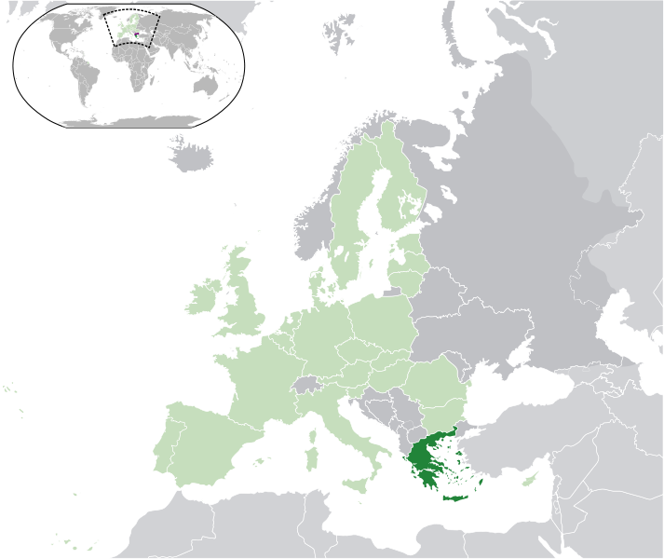
Location of greece
Our country is in the Southeast Europe, in the Balkan peninsula.
Our flag:
Greece
Notes:
Insert a map of your country.

Slide 3
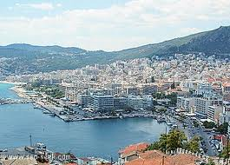
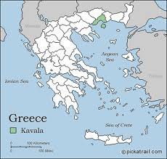
Our school is located in Nea karvali, kavala.
Our school is in Nea Karvali, a village near Kavala which is a beautiful town in the North East part of Greece.

Slide 4
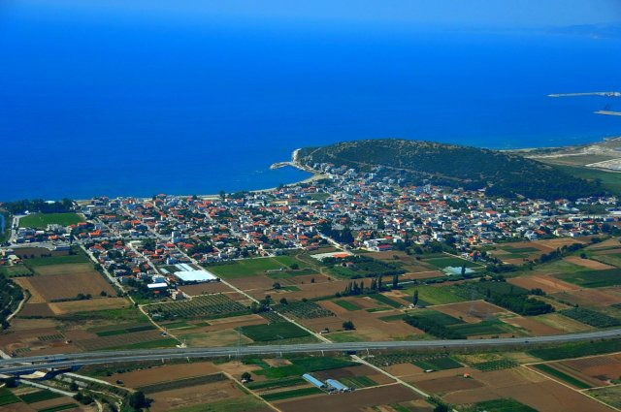
Nea karvali
Nea Karvali is a coastal , beautiful village and there are many interesting sights to visit. Our grandparents were repatriated from Asia Minor in 1924. So we are sensitive to issues of refugees!!!

Slide 5
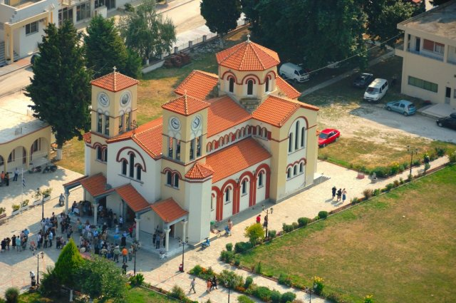
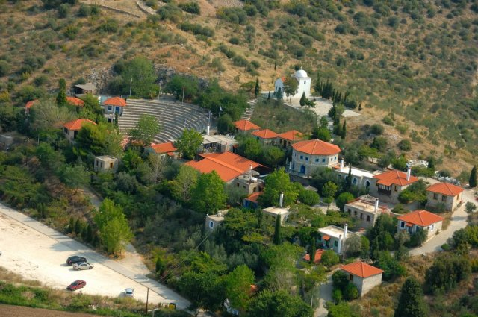
The most popular attractions
in our village are:
the church of
St. Grigorios
the cultural
village “Akondisma”

Slide 6
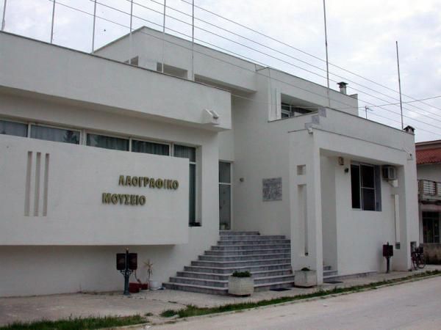
and the Historical , Ethnological , Folklore Museum .“SUN AND STONE” festival takes place every summer.

Slide 7
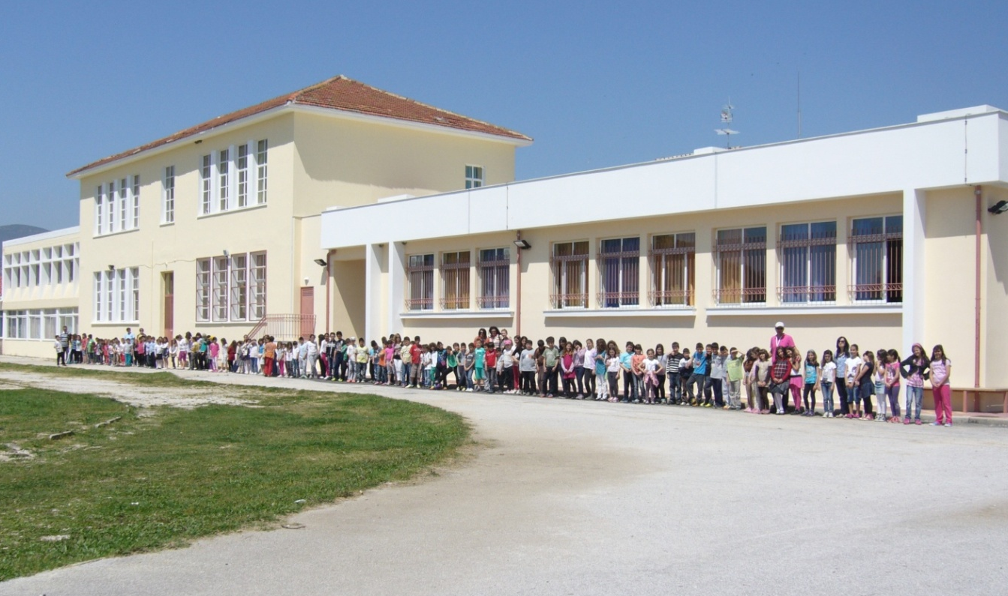
OUR SCHOOL
The age of our pupils is between 6 to 12 and this year there are 160 pupils and 10 classes in total.
There 20 teachers in the school that teach different subjects.
There is also a class for pupils with learning difficulties and a special class for refugees and immigrants that do not speak Greek.

Slide 8
Immigrants and refugees
Forty pupils come from other countries and in particular 25 are immigrants and 15 are refugees.
Difficulties
The fact that most of the refugees consider Greece as a «transit» country
The traumatic experiences and mental injuries they had
The possibility that that they were not attending school for a long time
The fact that they do not speak Greek.

Slide 9
Teaching program for refugees
We have welcomed refugee pupils with love and made sure that they feel comfortable.
We try to differentiate our teaching in order to fulfill all pupils’ needs.
Refugee pupils attend all six grades, according to their age.
At first, they are taught Greek in their special class and get extra help in maths. Then, they have P.E., English, maths, ICT and art with the rest of their classmates.

Slide 10
Sources:
http://el.wikipedia.org
www.sea-seek.com
www.opak.gr
Made by : Alexandros Iosifidis
Despina Iosifidou
Notes:
Insert a picture of one of the points of interest for your country.

Slide 11
Spas
شكرا لك
Thank you
Ευχαριστούμε
Kiitos
Ďakujem
Faleminderit
Teşekkür ederim
Gracias
Tack

